Slide 1
Exploring Plain Vision Transformer Backbones for Object Detection
2022 Mar 30
鄧仲恩
NTUST GAMELab

Slide 2
Outline
Introduction
Related Work
Method
Experiments
Conclusion
NTUST GAMELab

Slide 3
Introduction
NTUST GAMELab

Slide 4
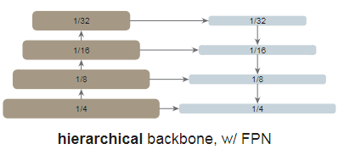
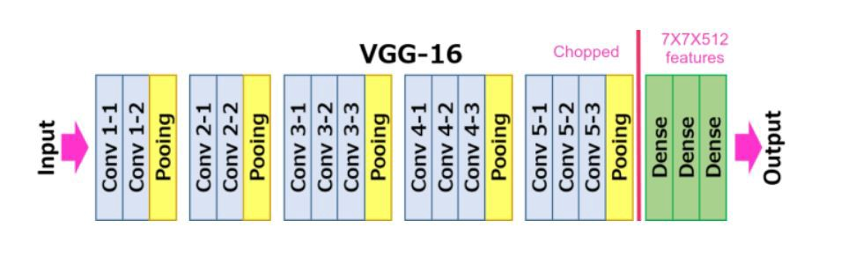
Introduction – Detection CNN base
Backbones
Neck
Head
VGG
ResNet
DarkNet
Region Proposal Networks (RPN)
Region-of-Interest (RoI)
Feature Pyramid Networks (FPN)
NTUST GAMELab
Notes:
ROI Pooling 統一anchor box 的尺度

Slide 5
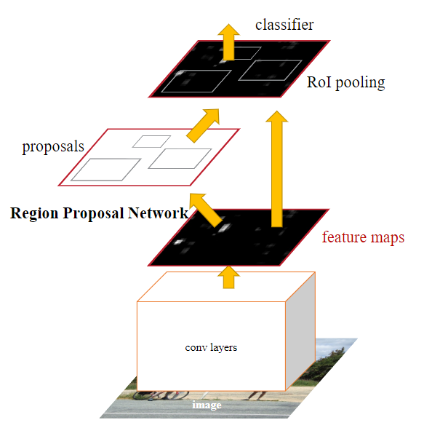
Introduction – Detection CNN base
NTUST GAMELab

Slide 6
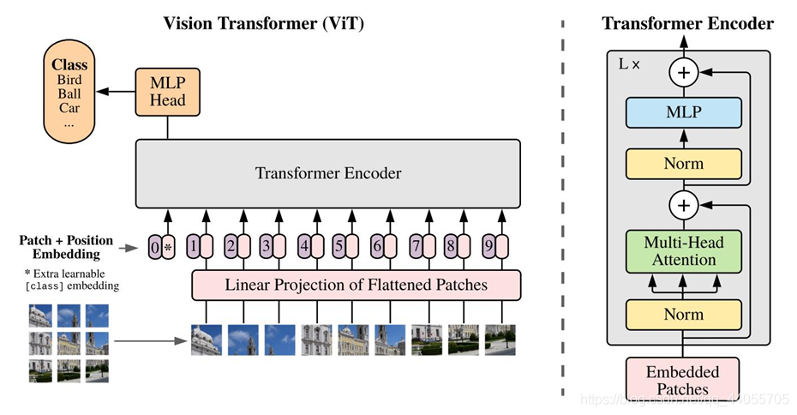
Introduction – Vision Transformers
Vision Transformers
Swin Transformers
NTUST GAMELab
Notes:
non-hierarchical
如何將Vit結合FPN

Slide 7
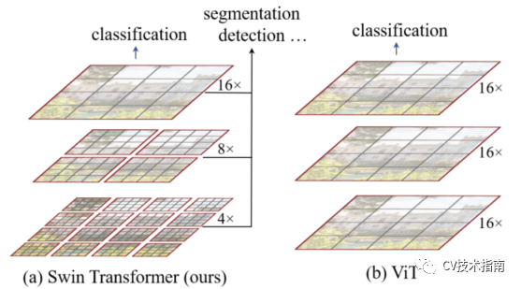
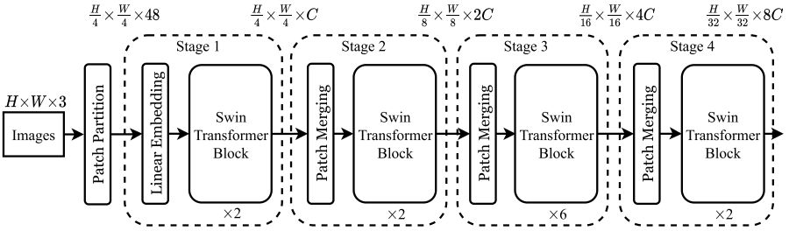
Introduction – Swin
NTUST GAMELab

Slide 8
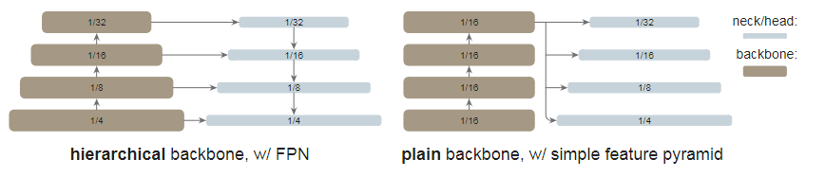
Introduction – Target
Use plain, non-hierarchical backbones. (Vision Transformers )
Independence of upstream vs. downstream tasks.
Use a simple feature pyramid.
Use Masked Autoencoder (MAE) pretraining.
Compete with the hierarchical-backbone detectors. (Swin, MViT)
NTUST GAMELab
Notes:
2. Like ConvNet-based research

Slide 9
Related Work
NTUST GAMELab

Slide 10
Related Work - Object detector backbones
Pioneered by the work of R-CNN.
SSD is the first works that leverage the hierarchical nature of the ConvNet backbones (VGG).
FPN pushes this direction further by using all stages of a hierarchical backbone, approached by lateral and top-down connections.
ViT is a powerful alternative to standard ConvNets for image classification. (Swin , MViT , PVT , PiT)
NTUST GAMELab
Notes:
4.作者認為以Vit去取代主幹是可以輕易實現的

Slide 11
Related Work - Plain-backbone detectors
Vit
NTUST GAMELab
Notes:
4.作者認為以Vit去取代主幹是可以輕易實現的

Slide 12
Related Work - Object detection methodologies
Vit
NTUST GAMELab
Notes:
4.作者認為以Vit去取代主幹是可以輕易實現的

Slide 13
Method
NTUST GAMELab

Slide 14
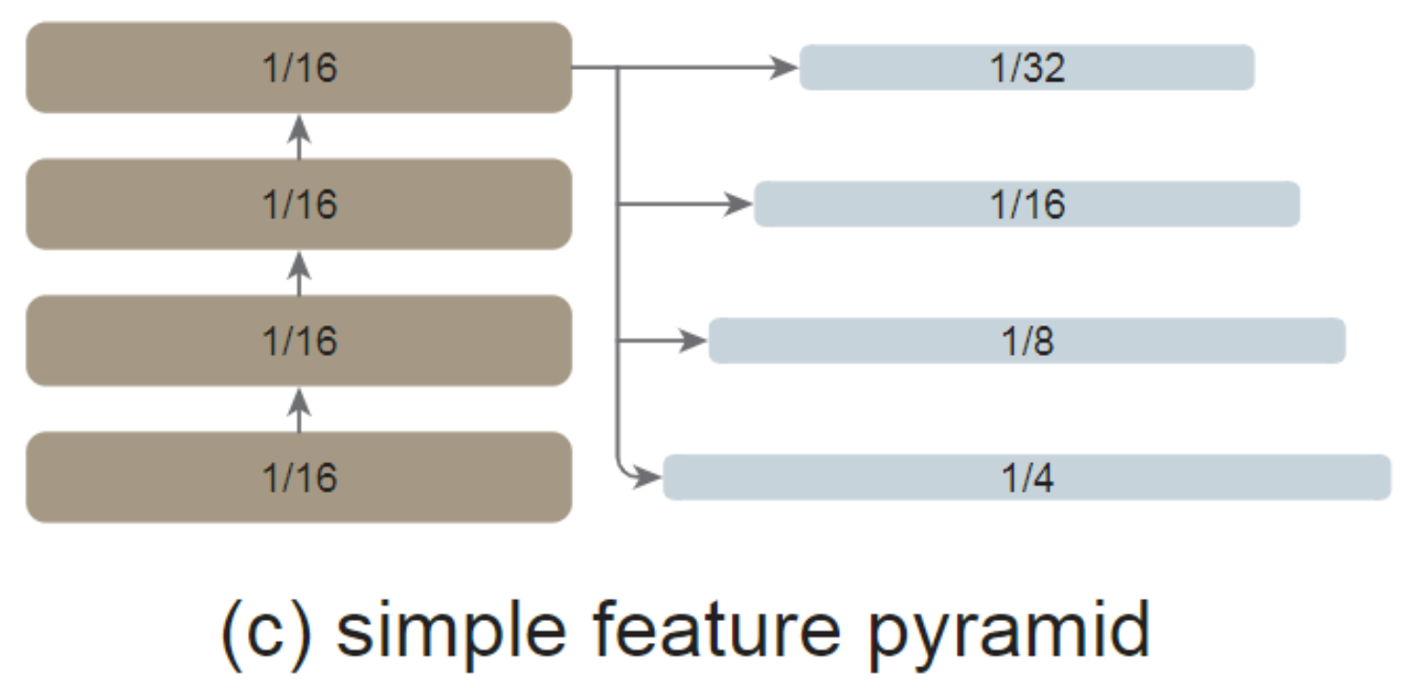
Method - Simple feature pyramid
Convolution
ViT
NTUST GAMELab
Notes:
想法來自SSD 但不一樣 只使用高層特徵
FPN通常由側邊連接 但使用ViT骨架來說 以作者經驗是不必要的 因在ViT中已可保留大部分有必要的特偵
作者在實驗是否Simple feature pyramid 表現比較好

Slide 15
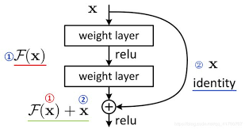

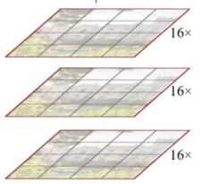
Method - Backbone adaptation
Global propagation
Convolutional propagation
propagation strategy
Simple feature pyramid
propagation strategy
Simple feature pyramid
propagation strategy
Simple feature pyramid
propagation strategy
Simple feature pyramid
NTUST GAMELab
Notes:
將網路分成4個subset 取最後一層執行傳播策略 就如 ViT-L就包含24-block
global self-attention
Convolutional 有殘差，值都預設成0，等價於 identity shortcut

Slide 16
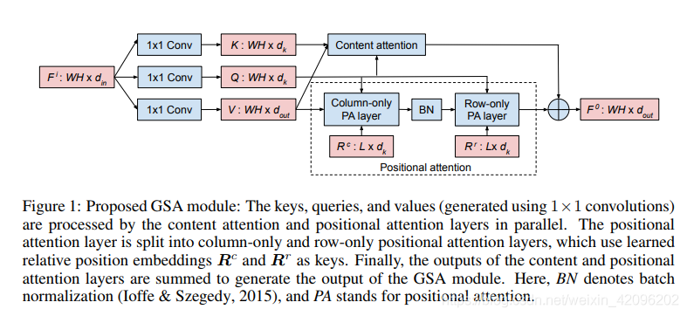
Method - Backbone adaptation
NTUST GAMELab

Slide 17
Method - Implementation
Pretraining backbones : ViT-B, ViT-L, ViT-H with MAE
Patch size : 16
Detector heads : Mask R-CNN or Cascade Mask R-CNN
Input image : 1024 X 1024
Augmented : large-scale jittering
Dataset : COCO train2017/val2017
Optimizer : AdamW
NTUST GAMELab
Notes:
global self-attention
Convolutional 有殘差，值都預設成0，等價於 identity shortcut

Slide 18
Experiments
NTUST GAMELab

Slide 19
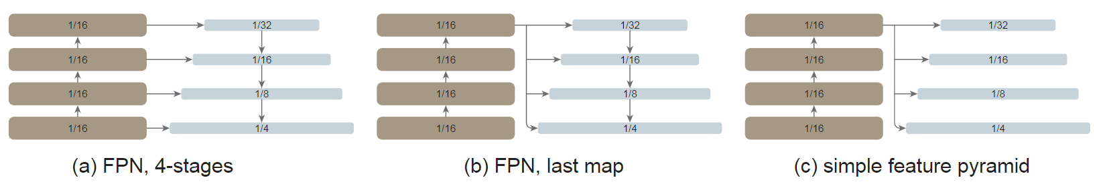
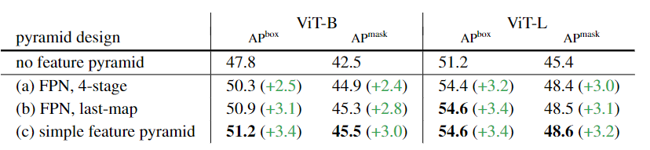
Experiments - Ablation Study and Analysis
NTUST GAMELab
Notes:
組件的對比實驗/性能分析
Both > base line 3.4 points 與FPN論文觀察是一至的
作者認為不需要 FPN 設計，簡單的特徵金字塔足以使ViT 主幹享受金字塔的好處。
第一次簡化結果
第二次簡化結果
一個簡單的特徵金字塔就足夠了

Slide 20
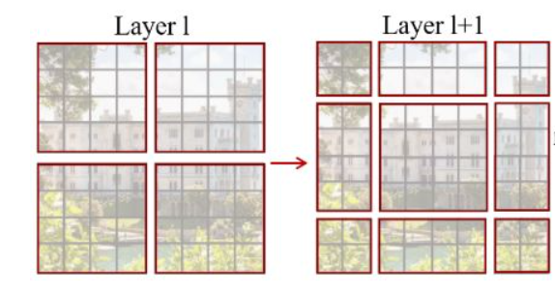
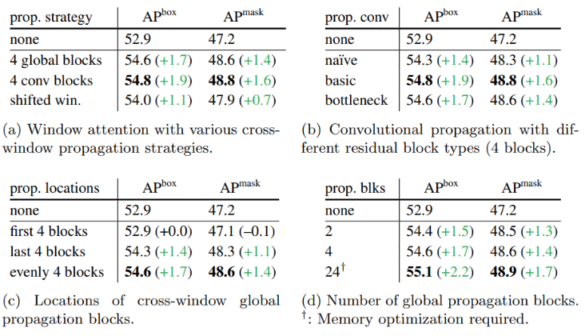
Experiments - Ablation Study and Analysis
A
B
Na ̈ıve : 3x3 conv
Basic : two 3×3 conv
Bottleneck : 1x1 -> 3x3 -> 1x1
NTUST GAMELab
Notes:
None 表示沒有傳播區塊 直接進入特偵金字塔
結論是不管怎樣的傳播區塊設計都比沒有傳播區塊好
A)Global self-attention
A)即使不用shifted windows, conv可以有更佳的結果
B)儘管捲機是局部的特偵抽取，但對於兩個窗口的連接已足以
C)都比baseline好。
C)均勻插入四個block 結果是好的
D)24層參數量會太多，導致momery與時間都大幅上升，不符合成本效益

Slide 21
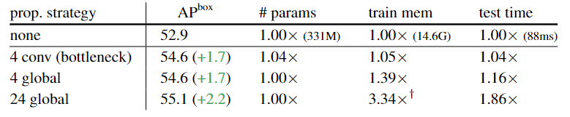
Experiments - Ablation Study and Analysis
NTUST GAMELab
Notes:
4 conv 只比 none 大4% 5% 4%
24global 問題

Slide 22
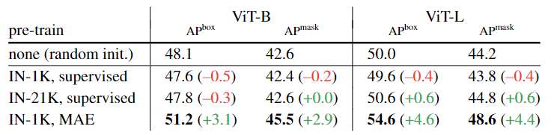
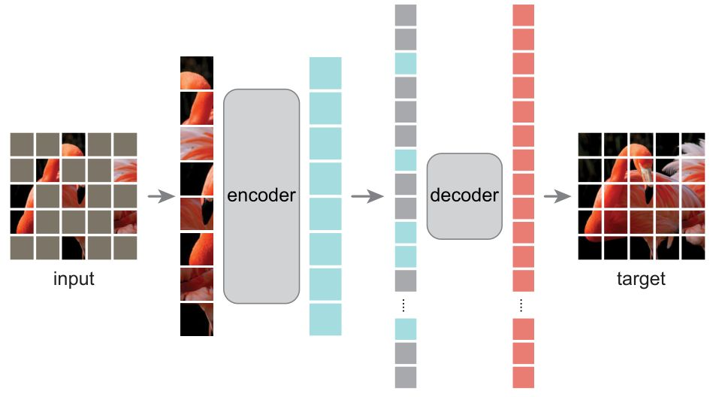
Experiments - Ablation Study and Analysis
NTUST GAMELab
Notes:
IN = ImageNet
MAE pretrain可用於緩解 overfitting的問題

Slide 23
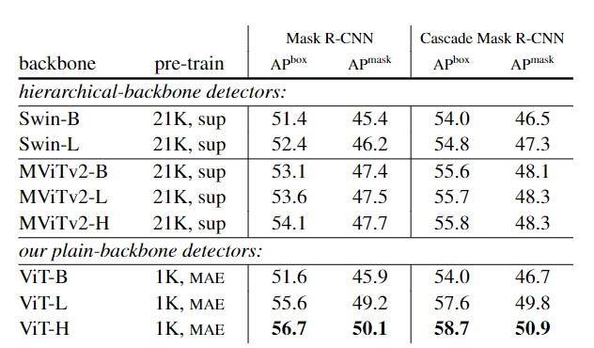

Experiments - Comparisons with Hierarchical Backbones
NTUST GAMELab
Notes:
relative position biases 加上約多AP 多一 point
plain-backbone detector+MAE 有最佳APbox 與 APmask

Slide 24
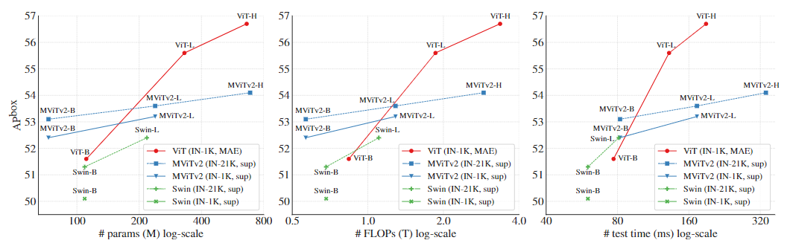
Experiments - Comparisons with Hierarchical Backbones
NTUST GAMELab

Slide 25
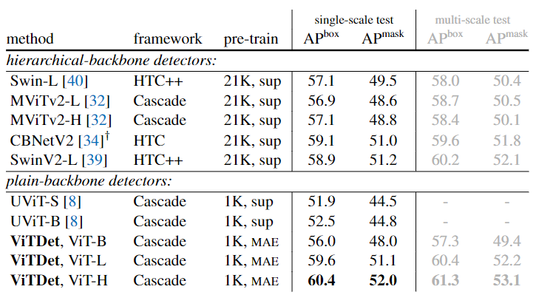
Experiments - Comparisons with Hierarchical Backbones
Comparisons on COCO
input size 1024->1080
adopt soft-nms
NTUST GAMELab
Notes:
UViT 也是plain-backbone detection method.

Slide 26
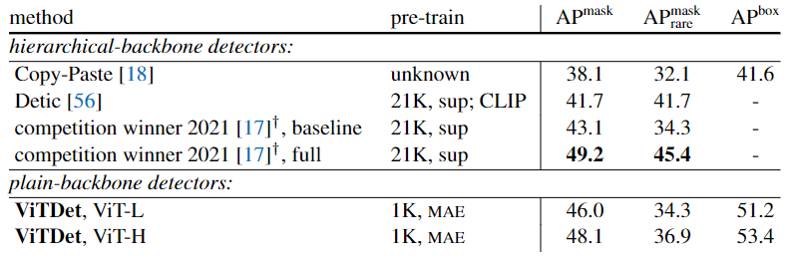
Experiments - Comparisons with Hierarchical Backbones
LVIS
1.1203 classes
2. long-tailed object distribution
Comparisons on LVIS
federated loss
repeat factor sampling
HTC+CBNetV2+2*Swim-L
NTUST GAMELab
Notes:
長尾分布 資料極度不平衡 <10
ViTDet呈現了具有競爭力的性能
2021 competition winner‘s 結合HTC 和 CBNetV2，結合了兩個 Swin-L 主幹

Slide 27
Conclusion
NTUST GAMELab

Slide 28
Experiments - Comparisons with Hierarchical Backbones
Comparisons on LVIS
input size 1024->1080
Adopt soft-nms
NTUST GAMELab

Slide 29
報告完畢 THE END
謝謝 Thank You
NTUST GAMELab

